Slide 1
Equine Welfare Concerns In WV

Slide 2
West Virginia State Codes
§19-10B-6. Investigation of complaints; board of review; orders of the commissioner; hearing; review.
(a) The commissioner of agriculture is hereby invested with the authority to, and shall upon the verified written complaint of any person or by his/her own initiative, investigate the actions of any livestock dealer, or any person who assumes to act in that capacity. Upon verification of the complaint that there is probable cause, the commissioner shall present the complaint and evidence to the board of review. The board of review shall consider all of the facts and recommend a course of action to the commissioner. The commissioner shall then issue an order.

Slide 3
West Virginia State Codes
§19-9-21. Animals entering state without health certificate.
It shall be the duty of the owner or owners of any domestic animal, which is to enter this state without a certificate of health, to notify the commissioner in writing stating when, where and how the animal is to be brought into this state. Such notice must reach the commissioner before the animal arrives at the point of destination. Any animal entering the state without a certificate of health may be placed in quarantine by the commissioner under such rules and regulations as he may approve, and held therein at the expense of the owner, and if such animal is found infected with any communicable disease, it shall, at the option of the owner, be killed, without compensation to the owner, or continued in quarantine at the expense of the owner. The expenses incurred in providing such animal or animals with proper quarters, food and water may be recovered by the commissioner from the owner in a suit in the name of the state, as other debts are by law collectible. It shall be unlawful to remove any such domestic animal from quarantine unless it shall have passed a satisfactory examination, and the tuberculin test in the case of bovine animals for dairy or breeding purposes, and unless the charge for the quarters, feed, water and attendance have been paid to the person entitled thereto.

Slide 4
West Virginia State Codes
§19-2C-6a. Investigation of complaints; board of review.
(a) The Department of Agriculture may, upon its own action, and shall upon the verified written complaint of any person, investigate the actions of any auctioneer, apprentice auctioneer, any applicant for an auctioneer’s or apprentice auctioneer’s license, or any person who assumes to act in that capacity, if the complaint, together with other evidence presented in connection with it, establishes probable cause. Upon verification of the complaint, the department shall present the complaint to the board of review. The board of review shall consider all of the facts of the complaint and recommend a course of action to the commissioner.
§19-2A-15. Annual meetings to establish uniform standards, grades and market practices.
The commissioner shall annually, on or before July 1, call together in public meeting the president and manager, or other officials, of livestock auction markets within the state for the purpose of establishing uniform standards and grades of livestock and uniform market practices and procedures for the operation of livestock auction markets in this state.

Slide 5
West Virginia State Codes
19-2c-10. Advertising
In advertising an auction sale by any licensed auctioneer, the principal auctioneer or auctioneers who physically conduct the sale shall be listed prominently in such advertising as used by said auctioneer or auctioneers. The individual auctioneer or auctioneers who conduct the sale shall be the person or persons who call for, accept and close bids on the majority of items offered for sale.
Any apprentice auctioneer who advertises, as provided in this section, shall indicate in his or her advertisement the name of the sponsoring auctioneer under whom he or she is licensed.
The auctioneer’s name and license number shall be displayed in equal prominence with the name of the apprentice auctioneer and license number in such advertisement.
Nothing in the provisions of this article shall be construed so as to prohibit any other auc

Slide 6
TITLE 73 LEGISLATIVE RULE LIVESTOCK CARE STANDARDS BOARD
§73-1-10. Handling of disabled livestock.
10.1. The responsible party for ambulatory disabled, non-ambulatory disabled, or distressed
livestock shall provide appropriate protection from other animals, predators and weather extremes as
required by the condition of the animal.
10.2. The responsible party shall provide ambulatory disabled, non-ambulatory disabled or
distressed livestock with access to water.
§73-1-15. Standards of care for equine.
15.3.a. Horses shall be provided a diet sufficient to maintain a healthy weight and body
condition. In evaluating herd health, any individual Henneke body score of less than “three” (3) is
unacceptable; unless that animal is under the supervision of a licensed veterinarian. Geriatric or ill
horses may have less than an ideal weight and body condition.

Slide 7
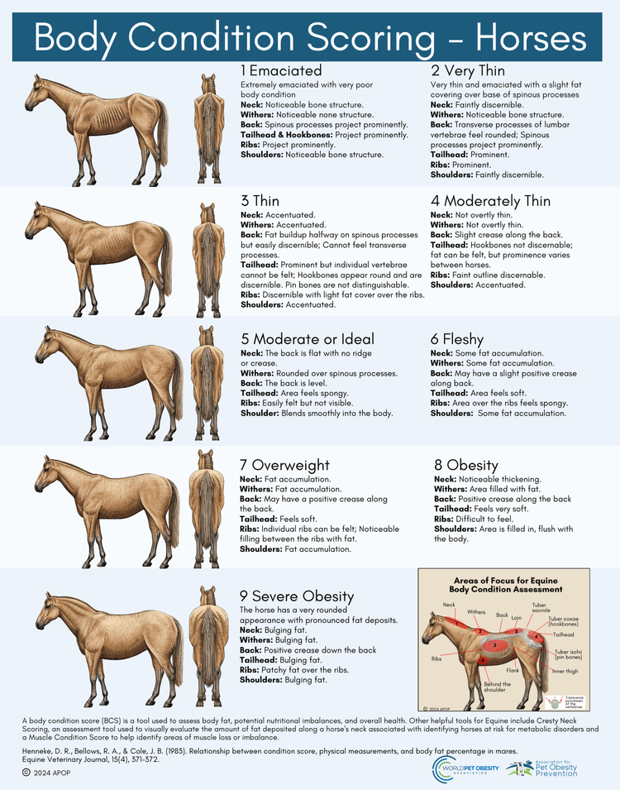
Equine BCS Henneke
Scale

Slide 8
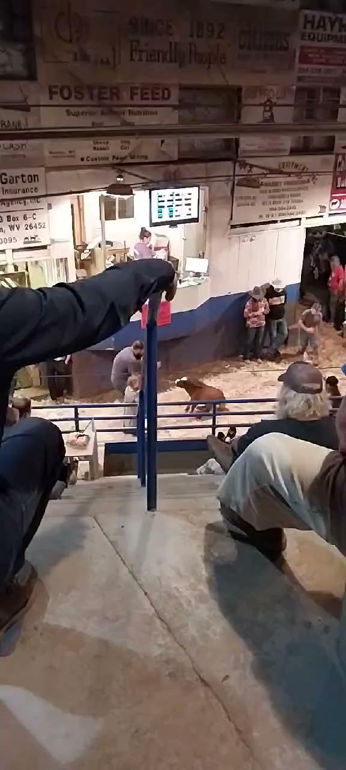
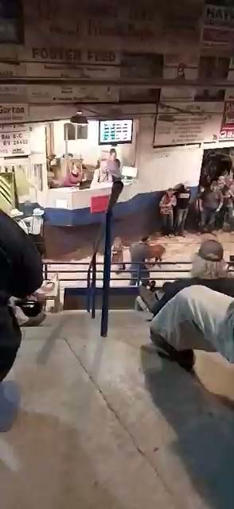
October 2023 - Weston Livestock Market

Slide 9
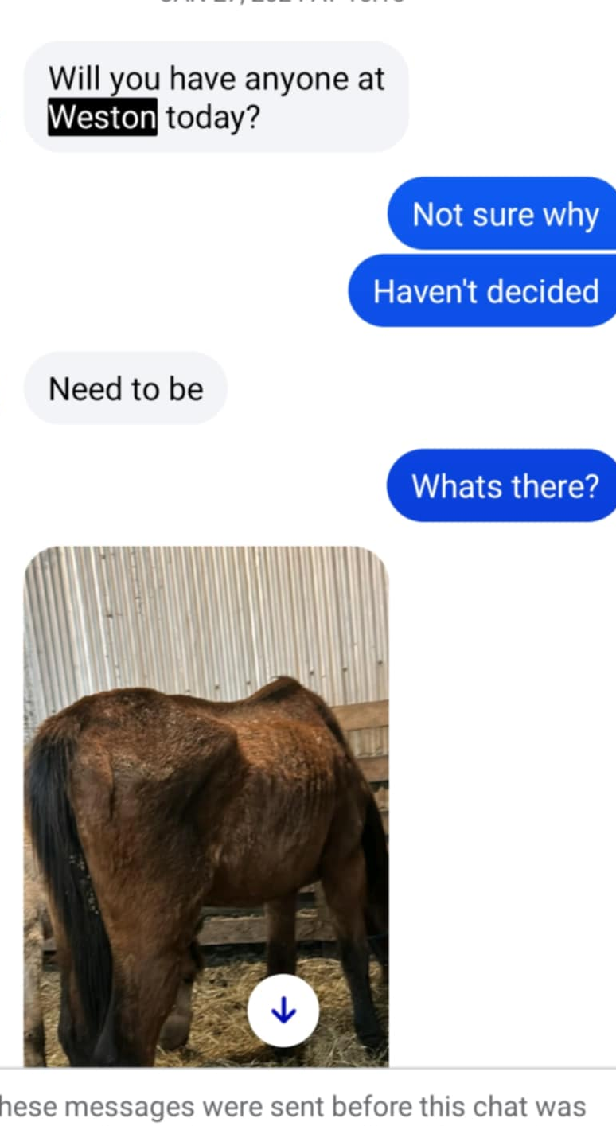
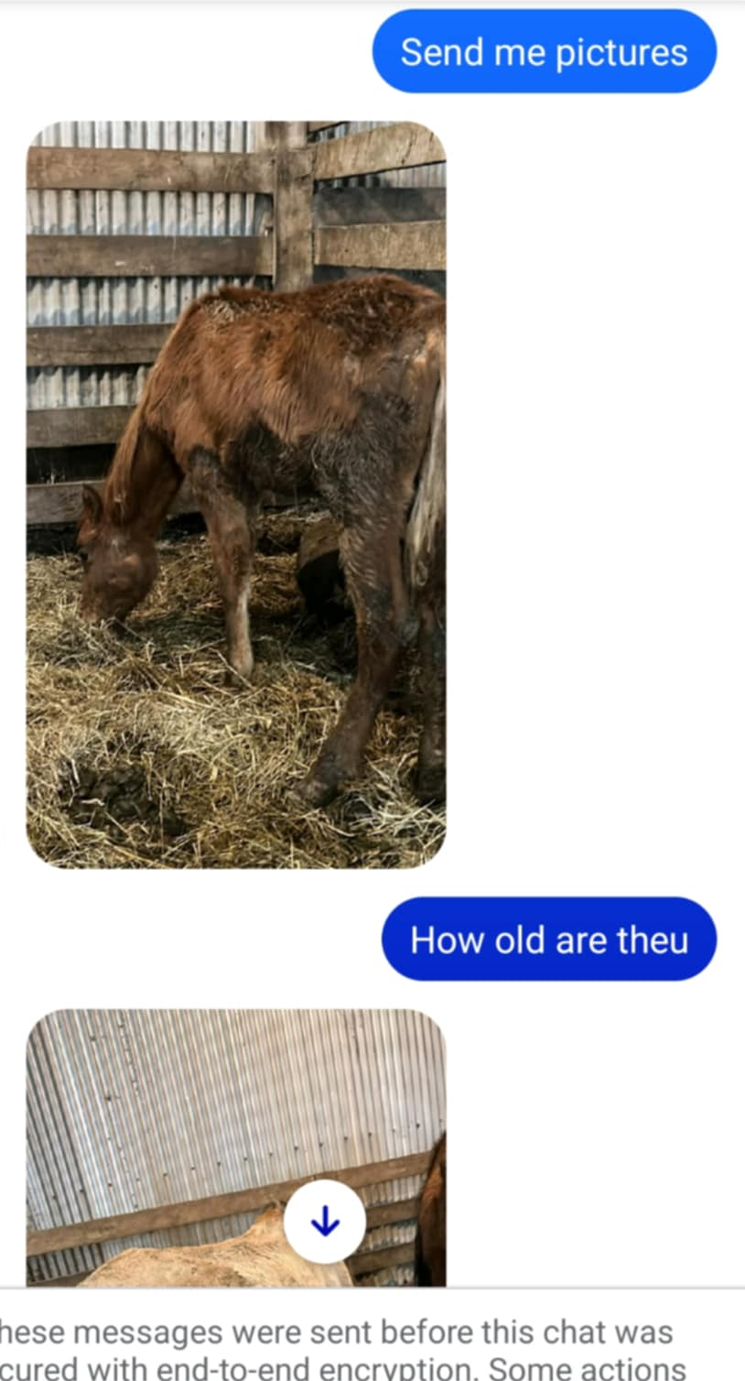
January 2024 - Weston Livestock Market

Slide 10
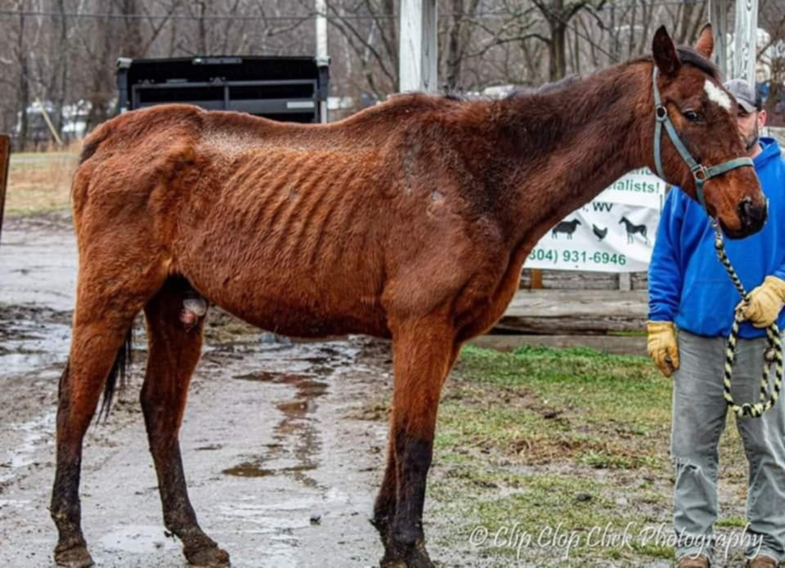
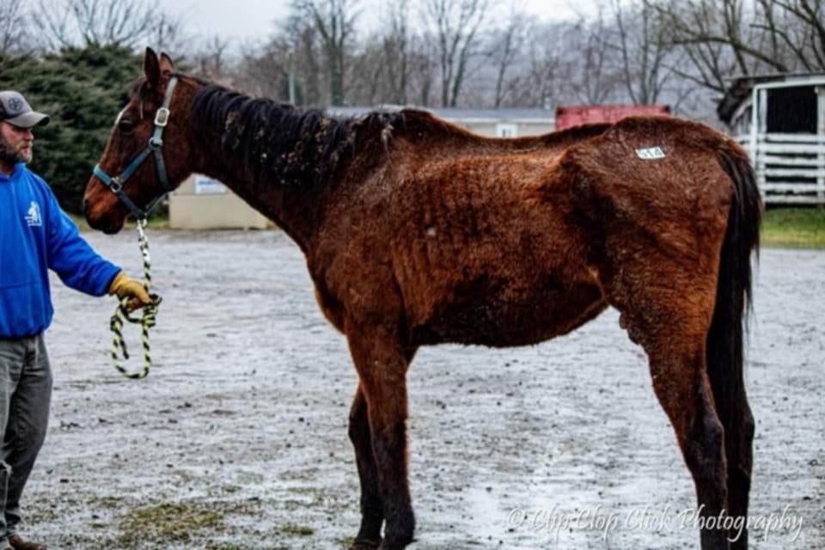
January 2024- Weston Livestock Market

Slide 11
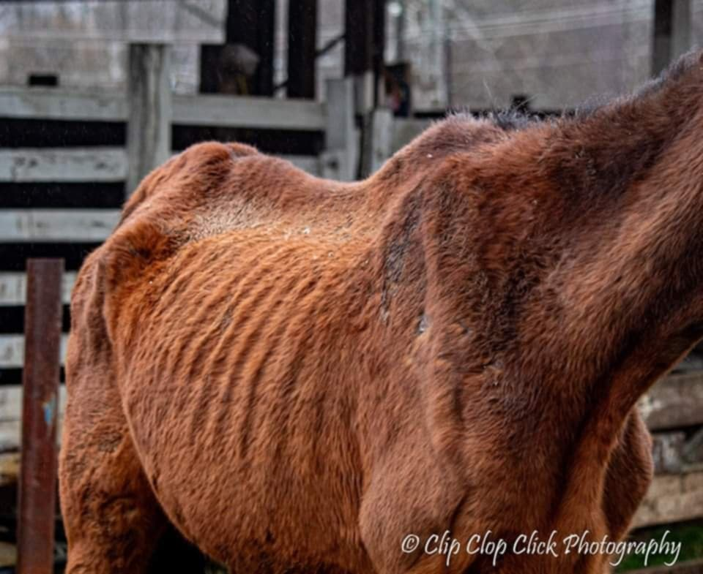
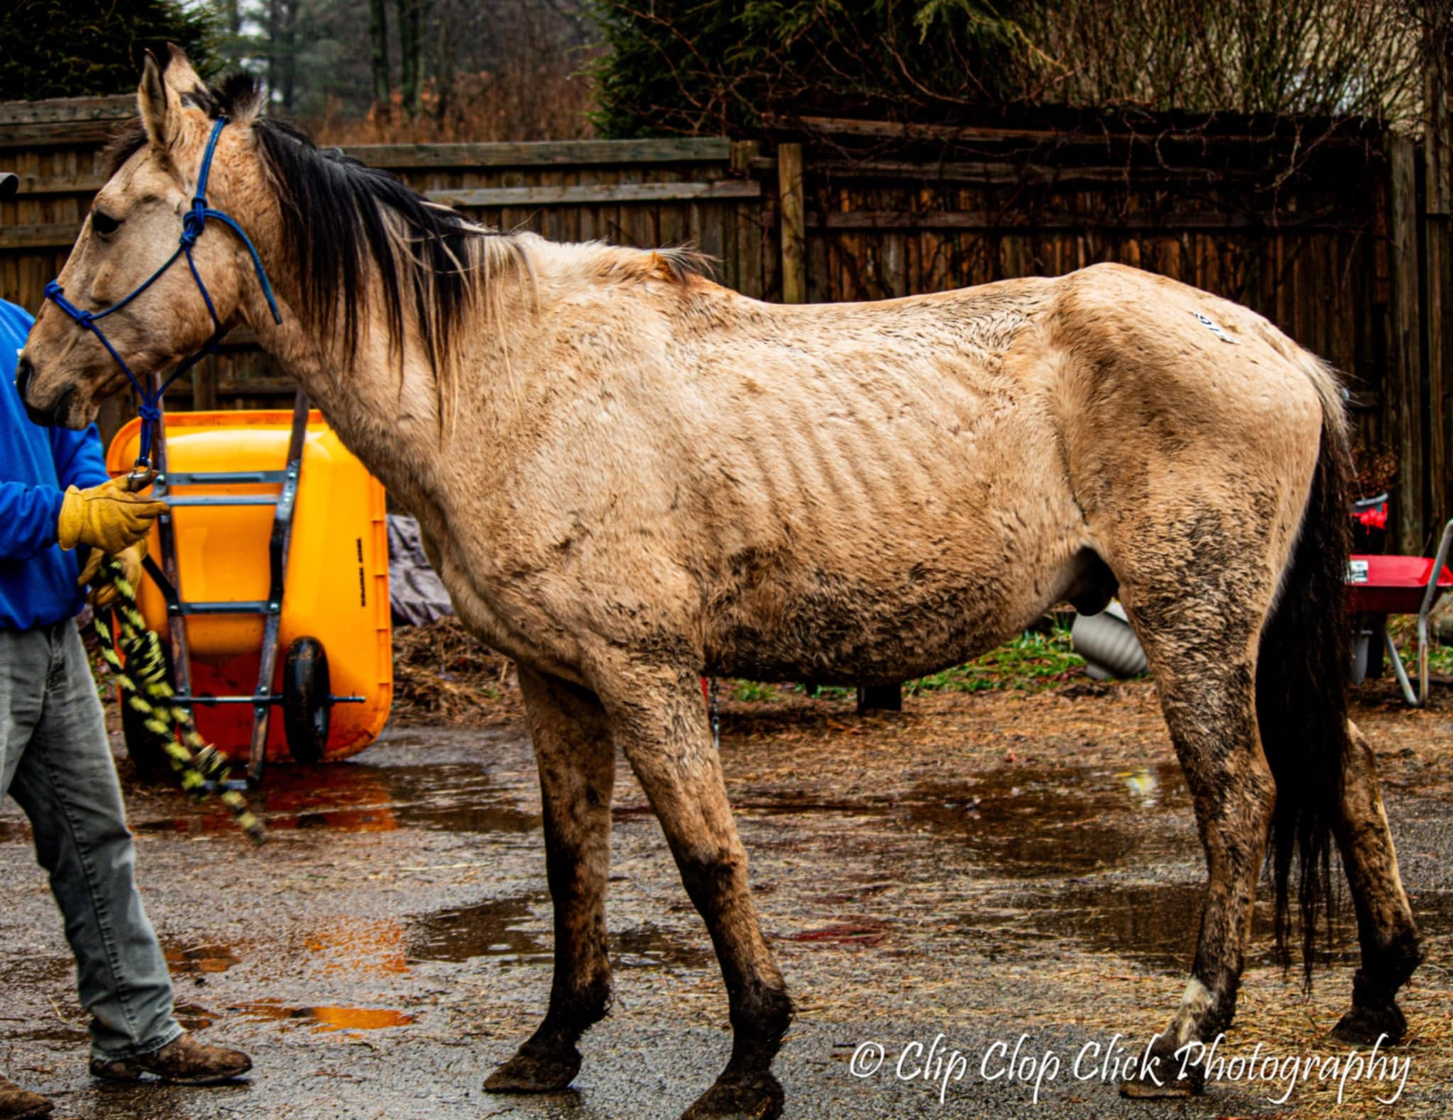
January 2024- Weston Livestock Market

Slide 12
February 2024- Weston Livestock Market

Slide 13
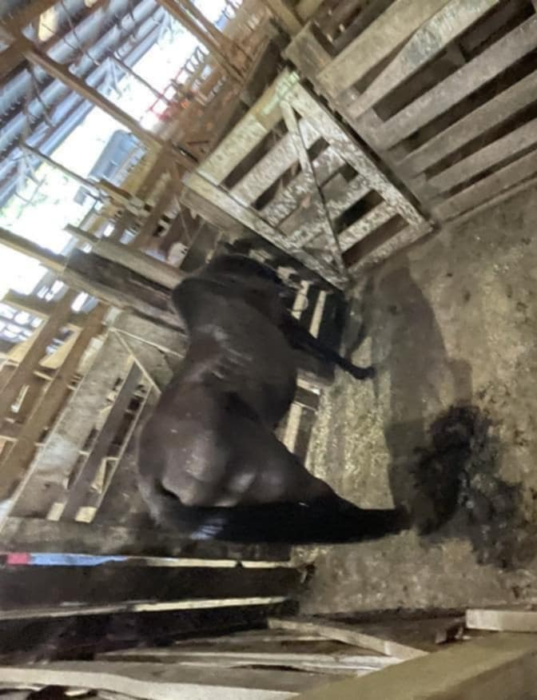
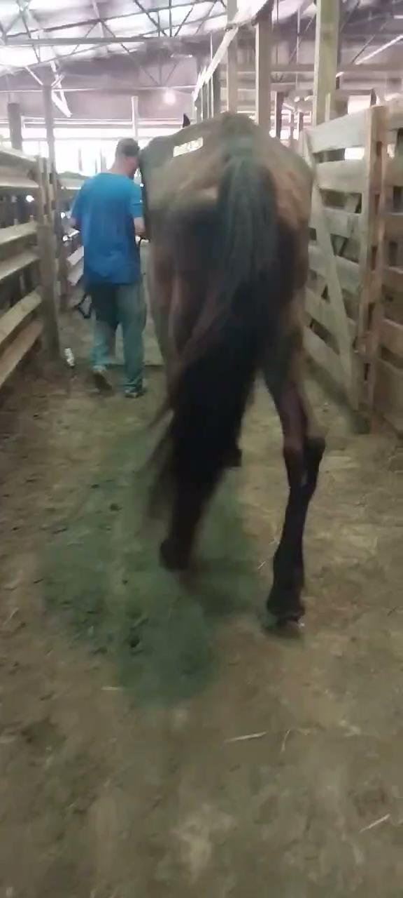
July 2024- Weston Livestock Market

Slide 14
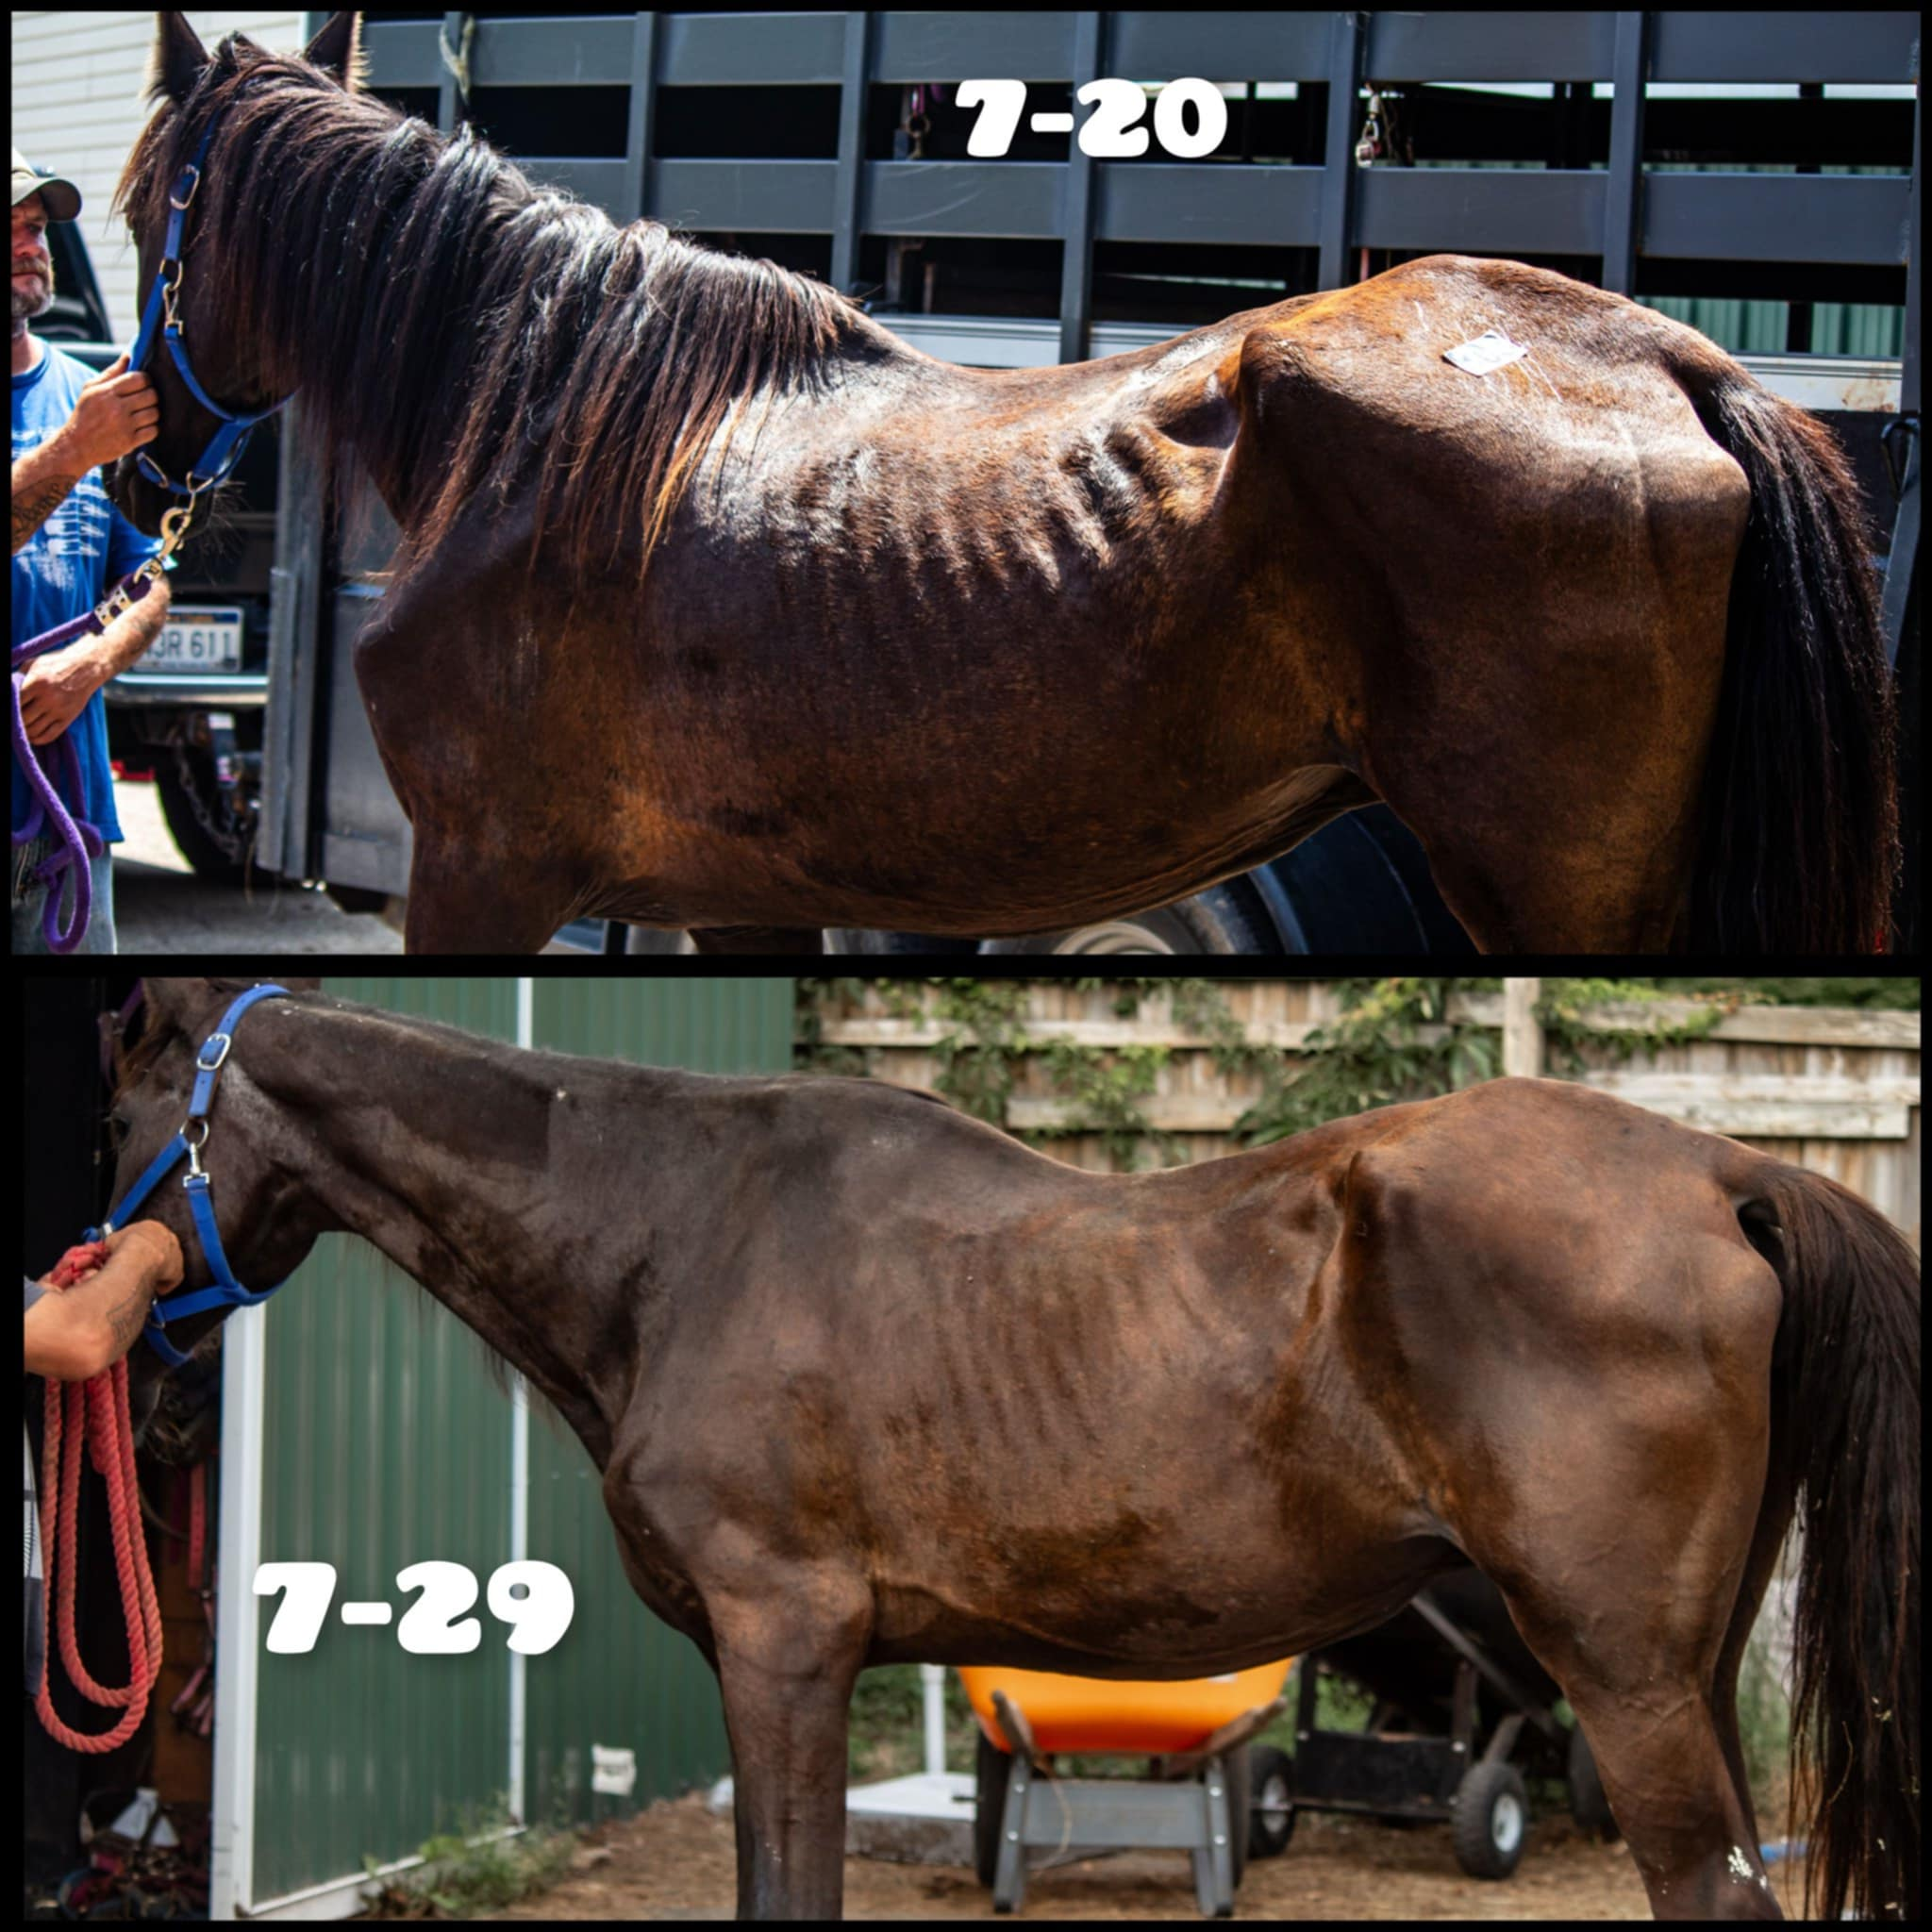
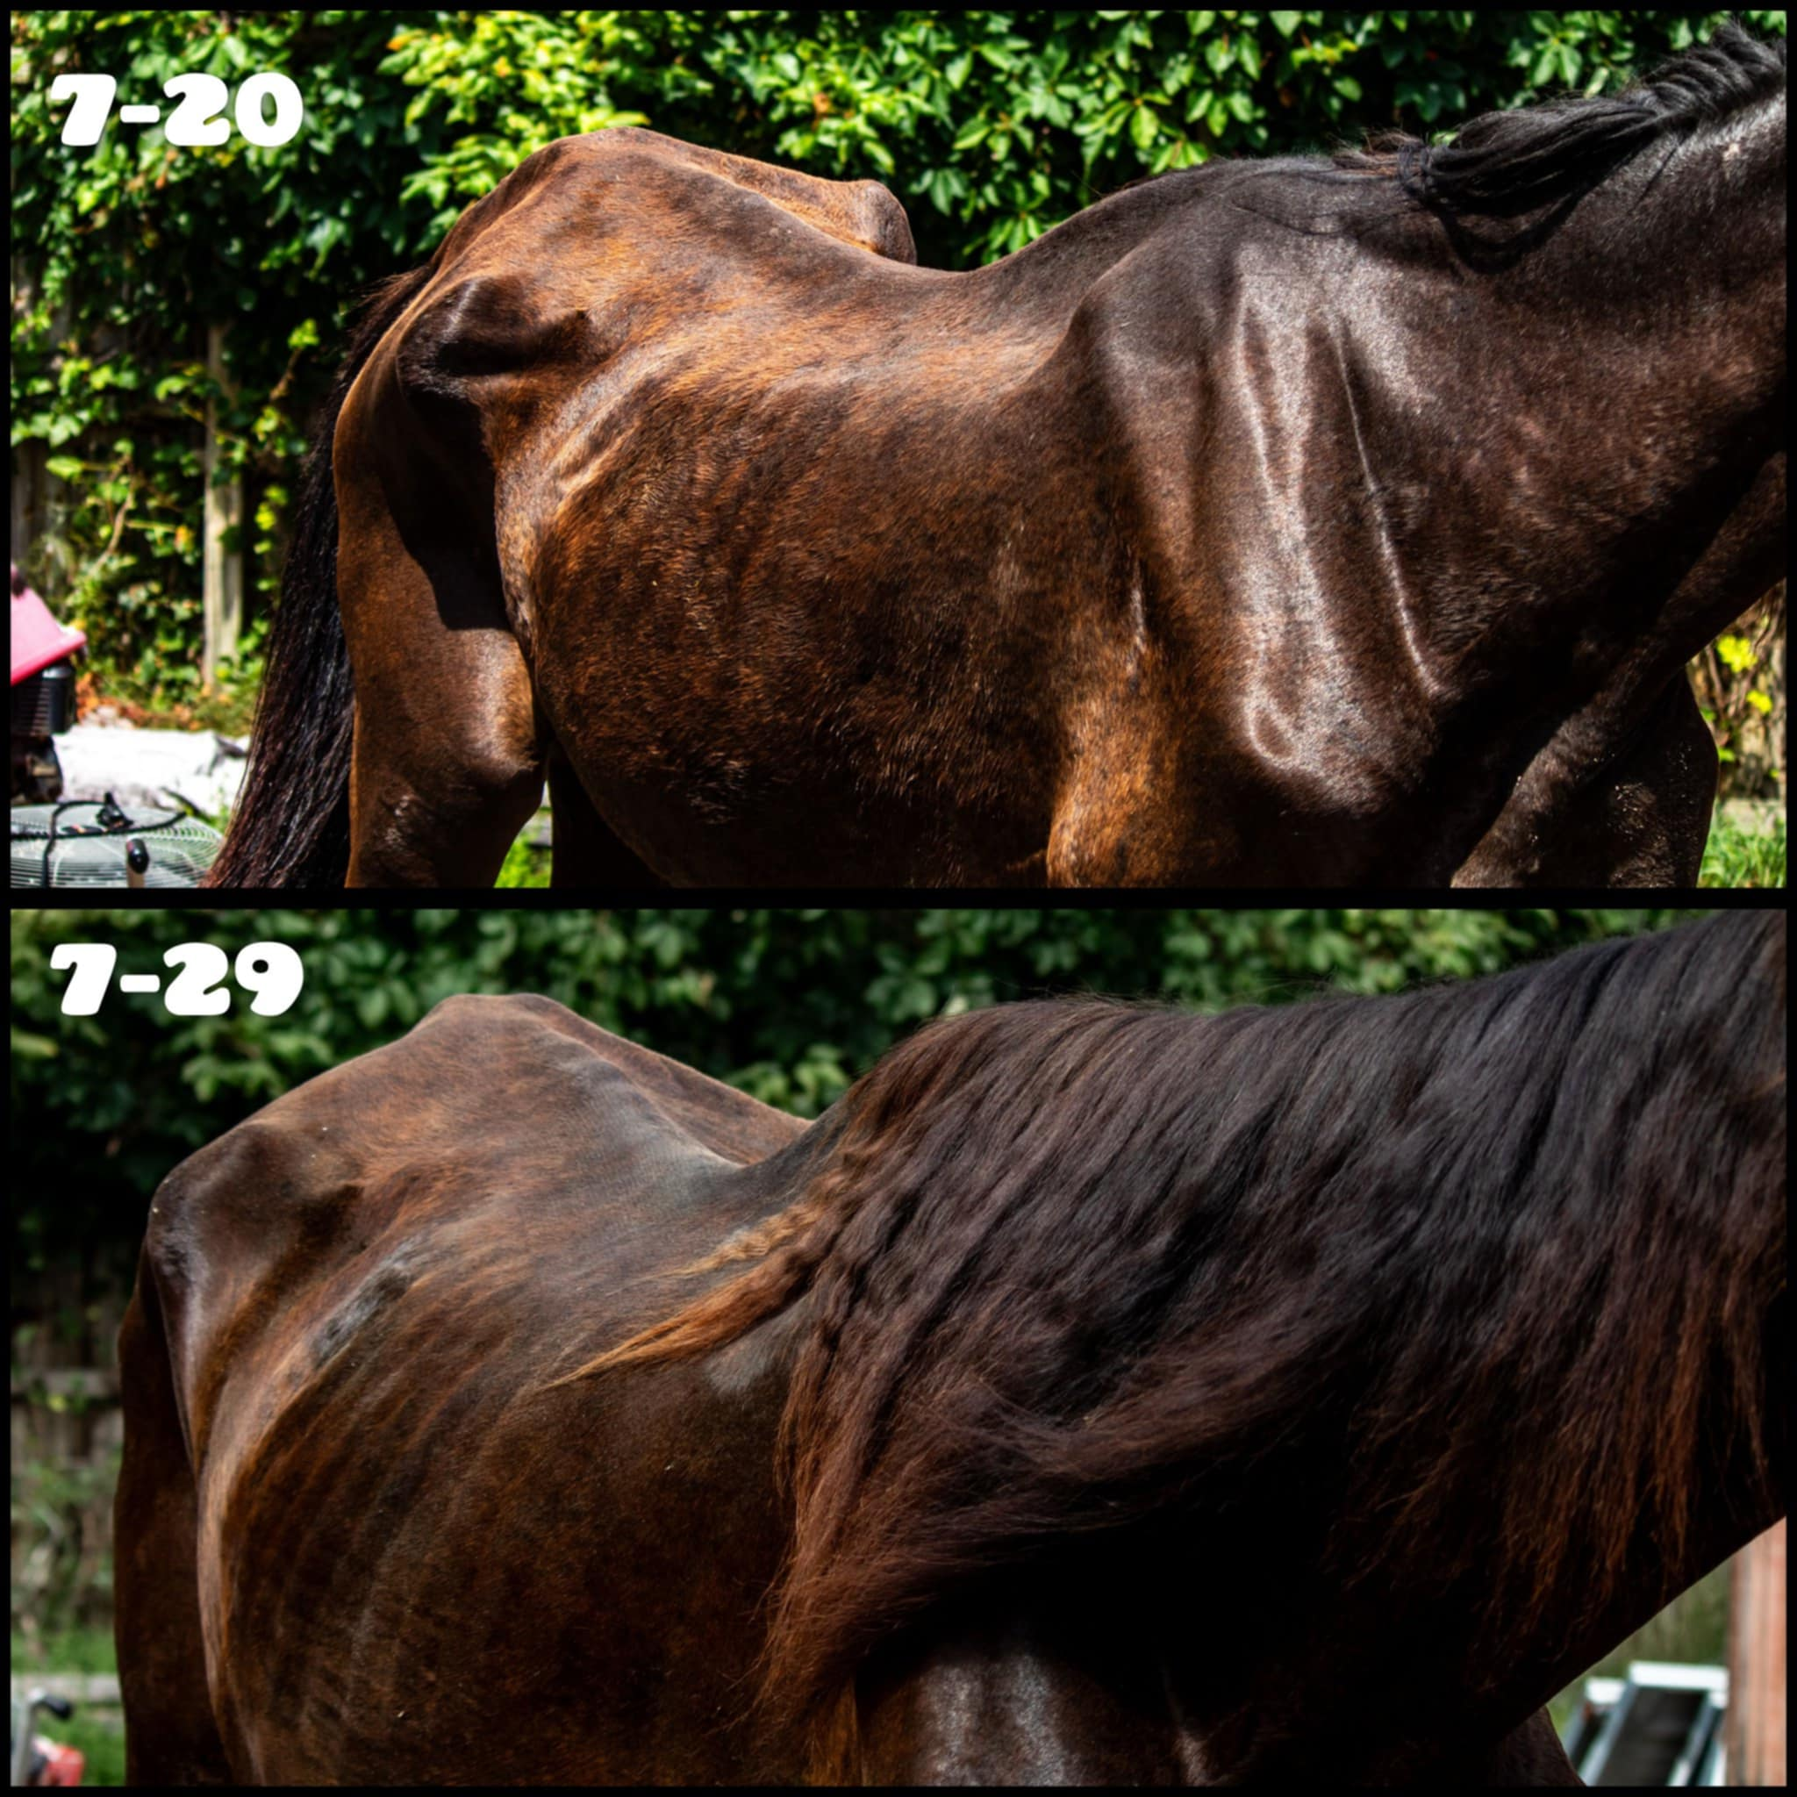
July 2024- Weston Livestock Market

Slide 15
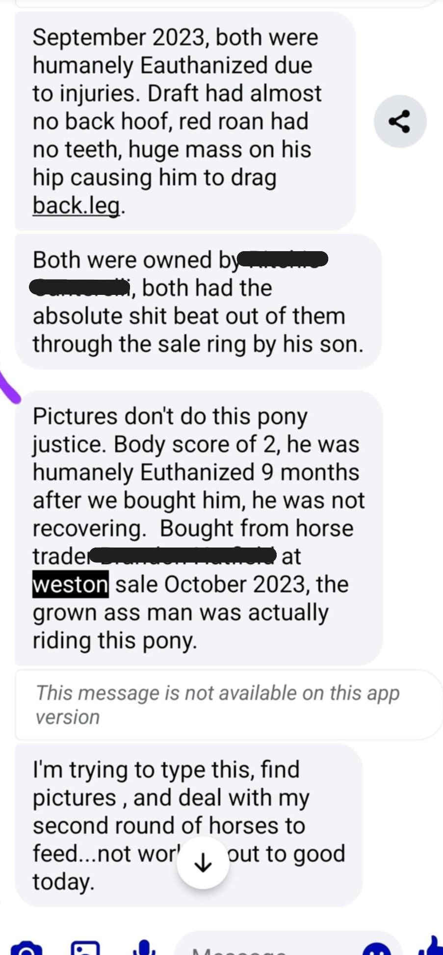
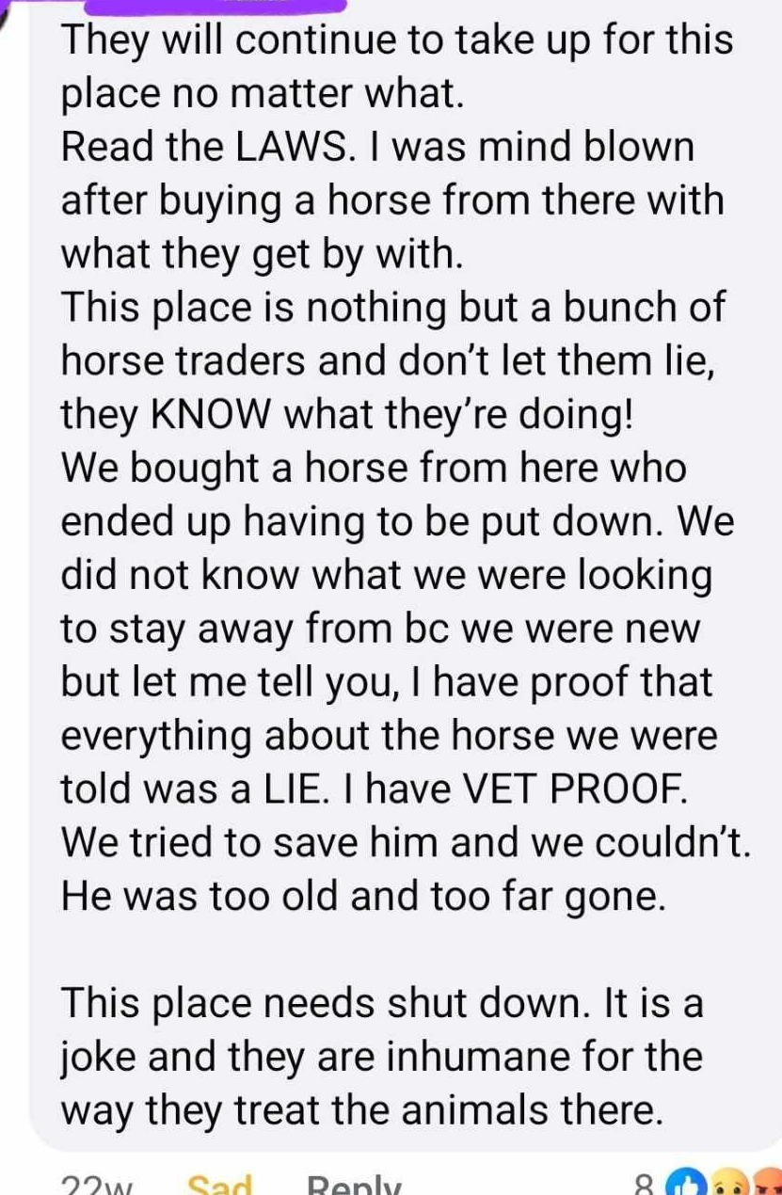
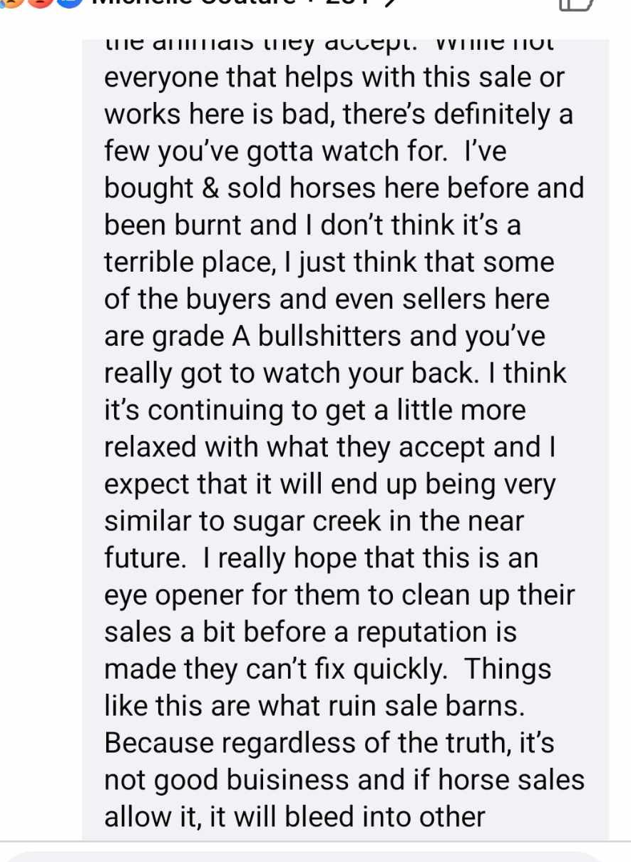
2024- Community Concerns

Slide 16
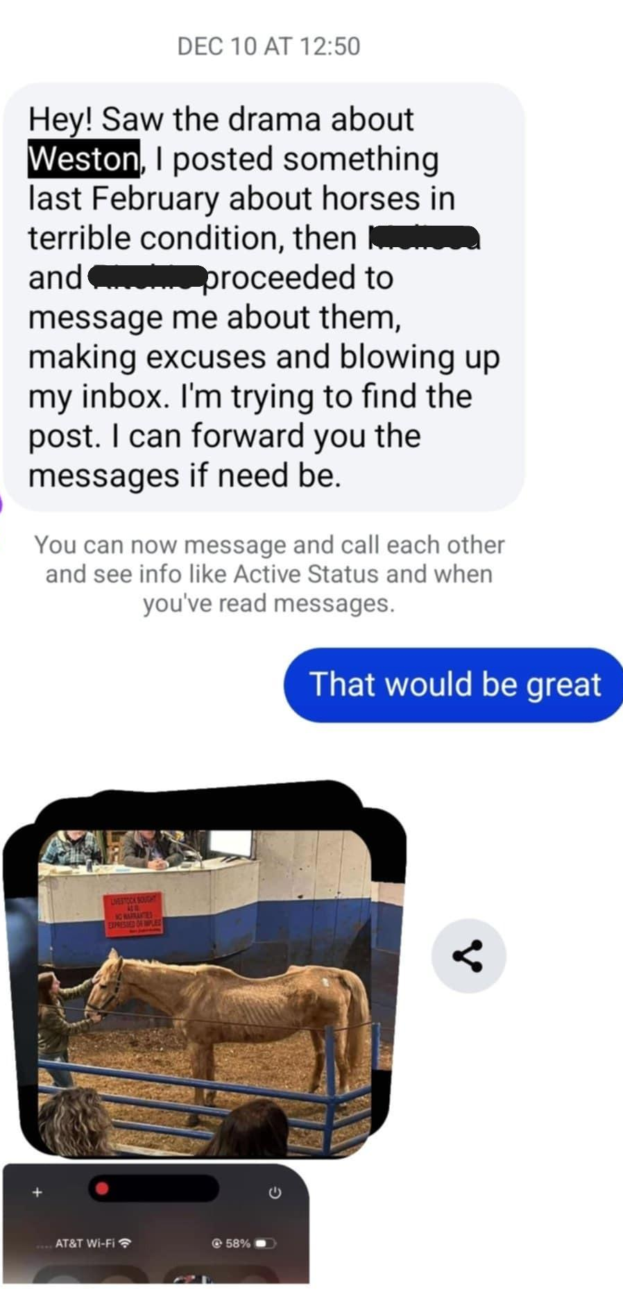
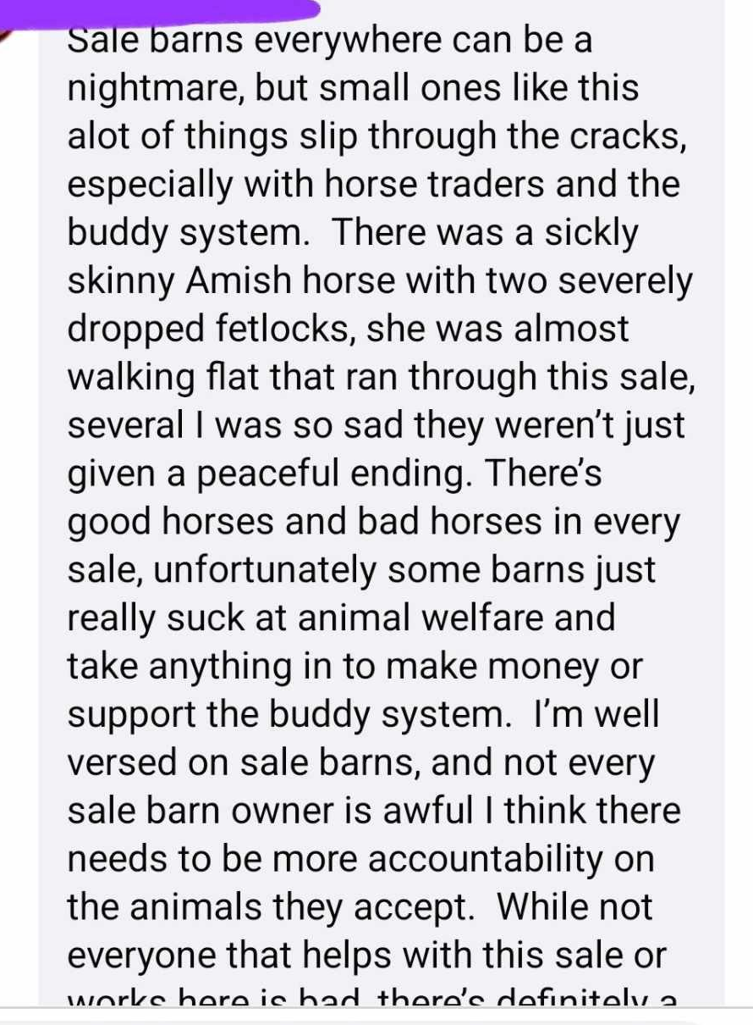
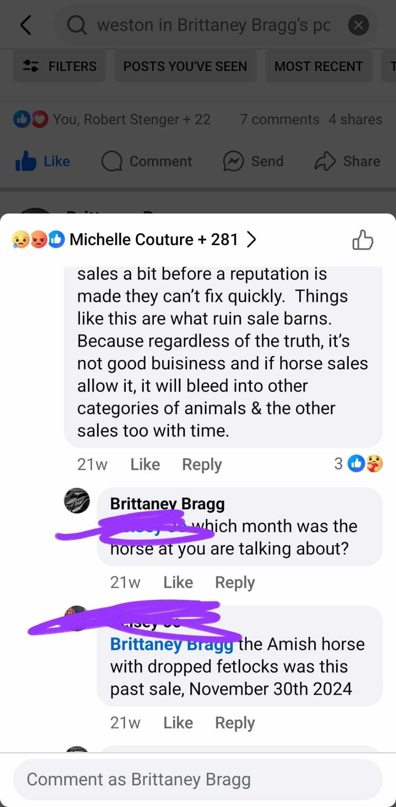
2024- Community Concerns

Slide 17
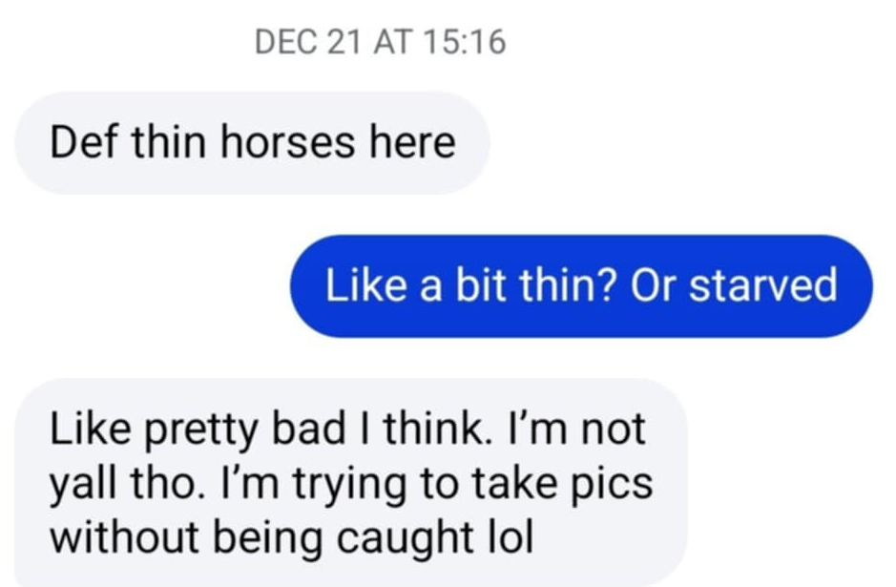
2024 Community Concerns

